Slide 1


Slide 2
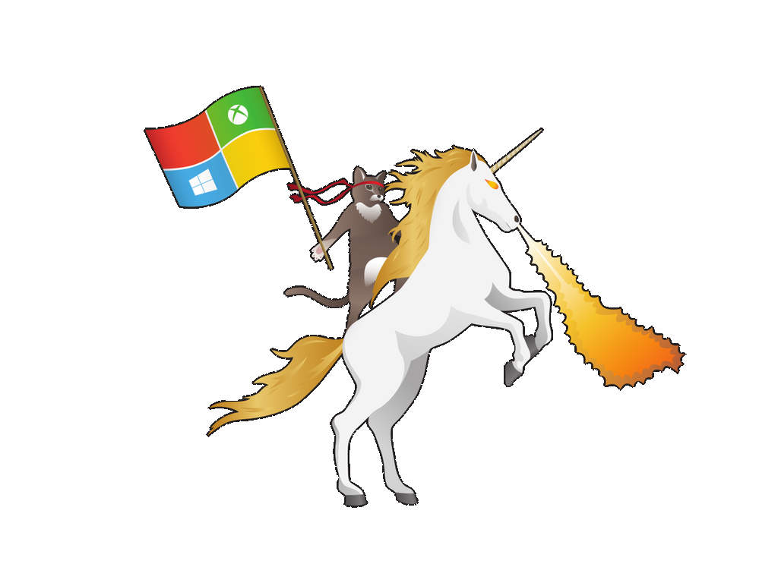
Windows Server 2016: le novità di Hyper-V
Francesco Valerio Buccoli
Premier Field Engineer
fbuccoli@microsoft.com

Slide 3
Agenda
Shielded VM
Virtual TPM
Key Storage Drive su Generation 1
VM Isolation
Linux Secure Boot
Discrete Device Assignment
Supporto a ReFS
Virutal Machine groups
Nested Virtualization
Custer Update
Cluster Node Quarantine
Cluster Compute Resiliency
Aggiunta NIC a caldo
Production Checkpoint
Memory Resize
Direct Device Assignment
Hyper-V Container
File VMCX
VHDS e Backup

Slide 4
Nano Server
A new headless, 64-bit only, deployment option for Windows Server
Deep refactoring with cloud emphasis
Cloud fabric & infrastructure (clustering, storage, networking)
Born-in-the-cloud applications (PaaS v2, ASP.NET v5)
VMs & Containers (Hyper-V & Docker)
Extend the Server Core pattern
Roles & features live outside of Nano Server
No Binaries or metadata in OS image
Standalone packages install like apps
Full driver support
Antimalware
Server with a Desktop Experience
Server Core
Nano Server

Slide 5
Component | Maximum | Notes
Logical processors | 512 | Both of these must be enabled in the firmware: - Hardware-assisted virtualization - Hardware-enforced Data Execution Prevention (DEP)
Memory | 24 TB | None.
Network adapter teams (NIC Teaming) | No limits imposed by Hyper-V. | For details, see NIC Teaming.
Physical network adapters | No limits imposed by Hyper-V. | None.
Running virtual machines per server | 1024 | None.
Storage | Limited by what is supported by the host operating system. No limits imposed by Hyper-V. | Note: Microsoft supports network-attached storage (NAS) when using SMB 3.0. NFS-based storage is not supported.
Virtual network switch ports per server | Varies; no limits imposed by Hyper-V. | The practical limit depends on the available computing resources.
Virtual processors per logical processor | No ratio imposed by Hyper-V. | None.
Virtual processors per server | 2048 | None.
Virtual storage area networks (SANs) | No limits imposed by Hyper-V. | None.
Virtual switches | Varies; no limits imposed by Hyper-V. | The practical limit depends on the available computing resources.
https://technet.microsoft.com/en-us/windows-server-docs/compute/hyper-v/plan/plan-for-hyper-v-scalability-in-windows-server-2016

Slide 6
Component | Maximum | Notes
Checkpoints | 50 | The actual number may be lower, depending on the available storage. Each checkpoint is stored as an .avhd file that uses physical storage.
Memory | 12 TB for generation 2; 1 TB for generation 1 | Review the requirements for the specific operating system to determine the minimum and recommended amounts.
Serial (COM) ports | 2 | None.
Size of physical disks attached directly to a virtual machine | Varies | Maximum size is determined by the guest operating system.
Virtual Fibre Channel adapters | 4 | As a best practice, we recommended that you connect each virtual Fibre Channel Adapter to a different virtual SAN.
Virtual floppy devices | 1 virtual floppy drive | None.
Virtual hard disk capacity | 64 TB for VHDX format; 2040 GB for VHD format | Each virtual hard disk is stored on physical media as either a .vhdx or a .vhd file, depending on the format used by the virtual hard disk.
Virtual IDE disks | 4 | The startup disk (sometimes called the boot disk) must be attached to one of the IDE devices. The startup disk can be either a virtual hard disk or a physical disk attached directly to a virtual machine.
Virtual processors | 240 for generation 2; 64 for generation 1 | The number of virtual processors supported by a guest operating system might be lower. For details, see the information published for the specific operating system.
Virtual SCSI controllers | 4 | Use of virtual SCSI devices requires integration services, which are available for supported guest operating systems. For details on which operating systems are supported, see Supported Linux and FreeBSD virtual machines and Supported Windows guest operating systems.
Virtual SCSI disks | 256 | Each SCSI controller supports up to 64 disks, which means that each virtual machine can be configured with as many as 256 virtual SCSI disks. (4 controllers x 64 disks per controller)
Virtual network adapters | 12 total: - 8 Hyper-V specific network adapters - 4 legacy network adapters | The Hyper-V specific network adapter provides better performance and requires a driver included in integration services. For more information, see Plan for Hyper-V networking in Windows Server 2016.

Slide 7
Shielded VMs
Shielded Virtual Machines
Shielded Virtual Machines
Shielded Virtual Machines
Shielded Virtual Machines can only run in fabrics that are designated as owners of that virtual machine
Shielded Virtual Machines will need to be encrypted (by BitLocker or other means) in order to ensure that only the designated owners can run this virtual machine
You can convert a running virtual machine into a Shielded Virtual Machine
HOST without TPM (generic host)
HOST with TPM
Host Guardian Service
Storage
Virtual hard disk
Virtual hard disk
Virtual hard disk

Slide 8
Upgrade
Virtual Machines
Virtual Machines
Virtual Machines
Virtual Machines
Virtual Machines
Road to Windows Server 2016 Cluster
Install a new node of migrate an old one
Migrate VMs to the other nodes
Upgrade or reinstal it as 2016
Keep going
You’re done and happy! ☺
Dotto
Pisolo
Gongolo
Dotto
Pisolo
Gongolo
Eolo
Eolo
Cucciolo
Storage
Virtual hard disk
Virtual hard disk
Virtual hard disk

Slide 9
Virtual Machine Upgrade
Compatibility mode: When a VM is migrated to a Windows Server 2016 host, it will remain in Windows Server 2012 R2 compatibility mode.
Upgrading a VM is separate from upgrading host.
VMs can be moved back to earlier versions until they have been manually upgraded.
Update-VMVersion vmname
Once upgraded, VMs can take advantage of new features of the underlying Hyper-V host.
Servicing model: VM drivers (integration services) updated as necessary.
Updated VM drivers will be pushed directly to guest operating system via Windows Update.
By running Update-VMVersion, VM will be upgraded to newest hardware version and can use the new Hyper-V features
Windows Server Technical Preview supports previous version VMs in compatibility mode
v6
v6
v6
v6
Windows Server 2012 R2 Hyper-V
Windows Server 2016 Hyper-V

Slide 10


VM Storage Resiliency
Resiliency
Designing for cloud scale with commodity hardware
Preserve tenant VM session state in the event of transient storage disruption
Cluster
Visibility
VM stack quickly notified on failure
Intelligent and quick VM response to block or file based storage infrastructure issues
Reliability
VM moved to PausedCritical state and will wait for storage to recover
Session state retained on recovery
VHD

Slide 11
New Backup for Hyper-V
No VSS in Host
Avoids creation of SAN snapshot for each virtual machine in a cluster when backing up.
Native Change Block API
Efficient, guaranteed by Microsoft, no more kernel mode drivers needed for backup.
Ecosystem Supported
All backup partners working to support now that reached GA. Key for backup on Nano.

Slide 12


Shared VHDX Integration
VHDX Resize
Guest Clusters can now resize Shared VHDX without downtime
Guest Cluster
Hyper-V Replica
Guest Clusters can now have Shared VHDX protected by Hyper-V Replica for disaster recovery
Host Level Backup
Guest Clusters can now have host level backups in addition to guest level backups of Shared VHDX
Shared
VHDX

Slide 13
Online VM Configuration Changes
Network
Network adapters can be added and removed from Generation 2 virtual machines while they are running
Memory
For Windows Server 2016 / Windows 10 guests, you can now increase and decrease the memory assigned to virtual machines while they are running.
Replicated Disks
When you add a new virtual hard disk to a virtual machine that is being replicated – it is automatically added to the not-replicated set. This set can be updated online.

Slide 14
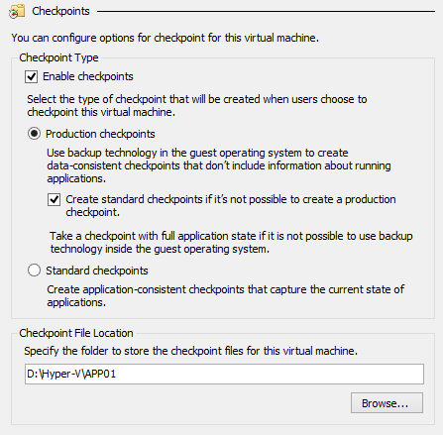
Production checkpoints
Full support for key workloads: Easily create “point in time” images of a virtual machine, which can be restored later on in a way that is completely supported for all production workloads.
VSS: Volume Snapshot Service (VSS) is used inside Windows virtual machines to create the production checkpoint instead of using saved state technology.
Familiar: No change to user experience for taking/restoring a checkpoint. Restoring a checkpoint is like restoring a clean backup of the server.
Linux: Linux virtual machines flush their file system buffers to create a file system consistent checkpoint.
Production as default: New virtual machines will use production checkpoints with a fallback to standard checkpoints.

Slide 15
PowerShell Direct
Enter-PSSession -VMName VMName
Invoke-Command -VMName VMName -ScriptBlock {Get-Blablabla}

Slide 16
Domande? Materiale su http://www.communitydays.it/

